Slide 1
Simulation and rendering of voxelized cloud volumes
RICKY ARIETTA
CIS 565 FINAL PROJECT FALL 2013
UNIVERSITY OF PENNSYLVANIA

Slide 2
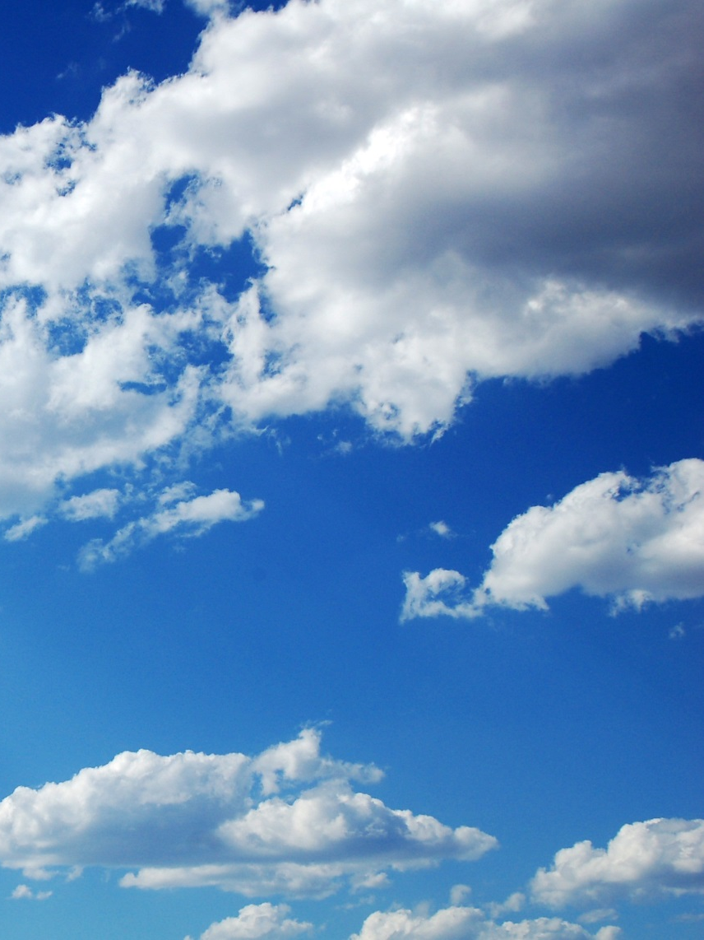
DESCRIPTION of project
WANT TO RENDER CLOUDS THAT MOVE AND RESPOND TO TRANSMITTANCE OF LIGHT IN BELIEVABLE WAY
USEFUL FOR AESTHETIC ANIMATIONS
DIVIDED INTO THREE MAIN PARTS:
INITIALIZATION OF CLOUD VOLUMES
SIMULATION OF CLOUD GROWTH/DECAY/MOTION
RENDERING

Slide 3
Part i: initialization of cloud volumes

Slide 4
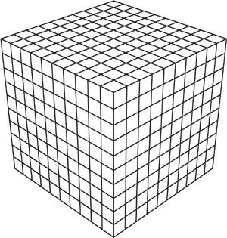
Part i: initialization of volumes
EACH VOLUME IS DEFINED BY A BOUNDING BOX INPUT FROM FILE ACCORDING TO A VOLUME STRUCTURE:
OUTLINE OF VOLUME DATA STRUCT:
bool isSet;
int volumeid;
int materialid;
float delt;
float step;
float velocity;
glm::vec3 xyzc;
glm::vec3 translation;
glm::vec3 rotation;
glm::vec3 scale;
cudaMat4 transform;
cudaMat4 inverseTransform;
voxel* voxels;

Slide 5
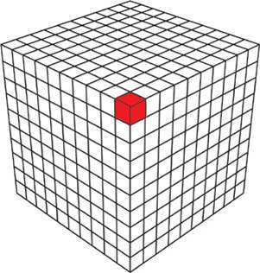
PART I: INITIALIZATION OF VOLUMES
EACH VOLUME STRUCT CONTAINS AN ARRAY OF VOXEL STRUCTS POINTING TO EACH INDIVIDUAL CLOUD PARTICLE
OUTLINE OF VOXEL DATA STRUCT:
char states;
float density;
float vaporProbability;
float extinctionProbability;
float phaseTransitionProbability;

Slide 6
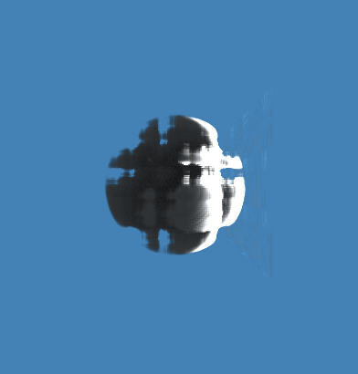
PART I: INITIALIZATION OF VOLUMES
DURING INITIALIZATION, A BLENDED PERLIN NOISE
FUNCTION IS GENERATED
UNBLENDED PERLIN NOISE RESTRICTED TO THE UNIT SPHERE AROUND THE ORIGIN

Slide 7
PART I: INITIALIZATION OF VOLUMES
EACH VOXEL’S ATTRIBUTES ARE INITIALIZED DEPENDING ON THEIR LOCATION IN THE BOUNDING VOLUME AND THE BLENDED PERLIN NOISE FUNCTIONS
ASSUME WE HAVE VOXEL[V] LOCATED AT POINT (X,Y,Z) IN THE VOLUME’S LOCAL SPACE
THEN…
float P = BlendedPerlinNoise(X,Y,Z)
density = P;
vaporProbability = P * 0.003f;
phaseProbability = P * 0.00003f;
extinctionProbability = (1.0f - P) * 0.9f;

Slide 8
PART I: INITIALIZATION OF VOLUMES
COPY EACH VOLUME’S PROPERTIES AND VOXEL ARRAY FROM THE DEVICE TO THE HOST SO THAT THEY CAN BE STORED FOR SIMULATION!

Slide 9
Part ii: cloud growth and simulation

Slide 10
PART II: GROWTH AND SIMULATION

Slide 11
Part iii: rendering

Slide 12
Part iii: rendering

Slide 13
Examples of final results

Slide 14
EXAMPLES OF CLOUD RENDERS

Slide 15
EXAMPLES OF CLOUD RENDERS
LIVE DEMO…

Slide 16
Analysis and discussion

Slide 17
Performance numbers
FRAME RATE IS VARIABLE, DEPENDING ON DENSITY OF CLOUD VOLUMES IN CAMERA VIEW
WITH 2 SIMULATED CLOUD VOLUMES (AS IN DEMO), RUNS AT BETWEEN 14-16 FPS ON MY LAPTOP

Slide 18
The end thank you!

